Slide 1
Benchmark Testing
Punam Rani Pal, Weiwei Chen

Slide 2
Systems Chosen
Local MySQL
- Relational database system with client/server architecture, easy to use
- Export/import databases
- Great medium to store data
- Good performance on simple queries
Cloud MySQL
- Take advantages of cloud deployment model
- Easy to set up, convenient to use
- High scalability and performance
BigQuery
- Work well with structured/unstructured data
- Serverless, computing source can be spun up on demand
- Scan Terabytes of data in seconds and Petabytes of data in minutes
- Load data from Google Cloud Storage, or Google Cloud DataStore, or stream into BigQuery storage

Slide 3
BenchMark Goals
Comparing three different systems ( Local MySQL, Cloud MySQL and BigQuery)
Performance Measurements (Based on Duration of execution):
- Full table scan
- Insert data into the existing table
- Delete an existing data
- Using Indices
- Joins (Indices/Non-Indices)

Slide 4
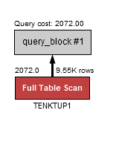
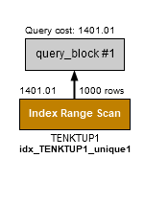
Experiment 1
Performance measures on different selectivity (with/without indices)
Example Query 1:
Find all the tuples with even number of unique1 which is less than 2000 (with/without indices) - Selectivity 10%
SELECT * From TENKTUP1 WHERE unique1 < 2000 AND unique1 % 2 = 0;

Slide 5
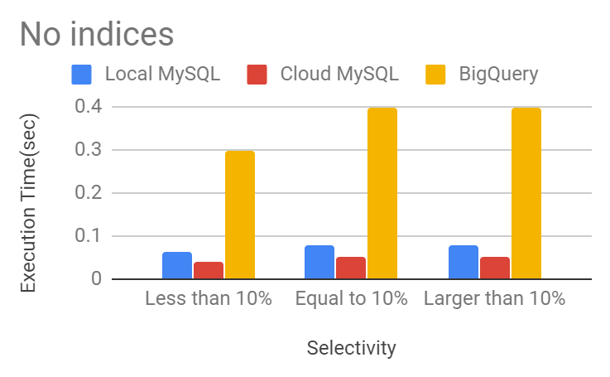
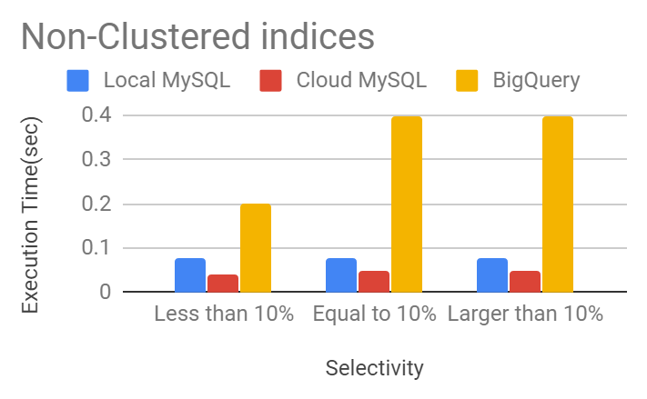
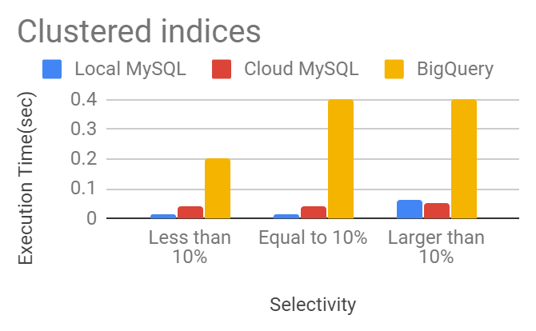
Results for The Experiment
* No indices, full scan
Selectivity | Local MySQL | Cloud MySQL | BigQuery
Less than 10% | 0.063 | 0.04 | 0.3
Equal to 10% | 0.078 | 0.05 | 0.4
Larger than 10% | 0.079 | 0.05 | 0.4
* Non-clustered indices, index range scan
Selectivity | Local MySQL | Cloud MySQL | BigQuery
Less than 10% | 0.079 | 0.04 | 0.2
Equal to 10% | 0.078 | 0.05 | 0.4
Larger than 10% | 0.078 | 0.05 | 0.4
* Clustered indices, index range scan
Selectivity | Local MySQL | Cloud MySQL | BigQuery
Less than 10% | 0.014 | 0.04 | 0.2
Equal to 10% | 0.015 | 0.04 | 0.4
Larger than 10% | 0.062 | 0.05 | 0.4

Slide 6
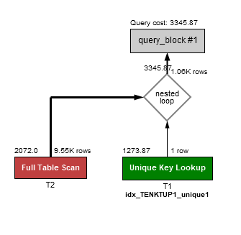
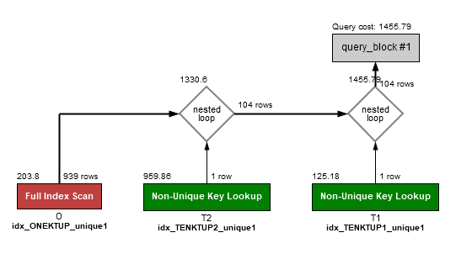
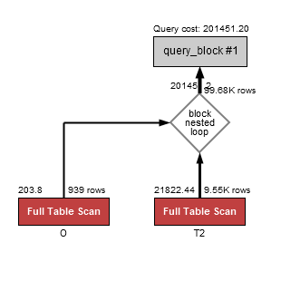
Experiment 2
Performance measures on Join
Example Query 2:
Find all the stringu1's that has ‘W’ in all the three relations. (with/without Indices)
SELECT T2.stringu1, T1.stringu1, 0.stringu1
FROM BENCHMARK_PRO.TENKTUP2 as T2, BENCHMARK_PRO.TENKTUP1 as T1, BENCHMARK_PRO.ONEKTUP as O
WHERE T2.unique1 = T1.unique1 AND T2.unique1 = O.unique1 AND T2.stringu1 like '%W%'

Slide 7
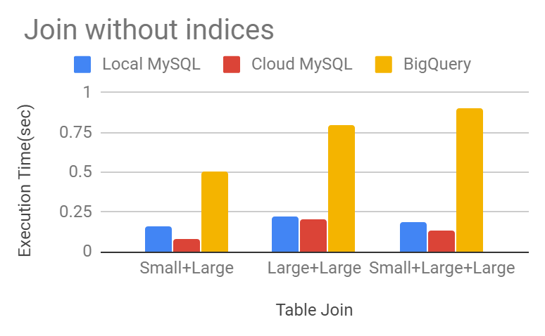
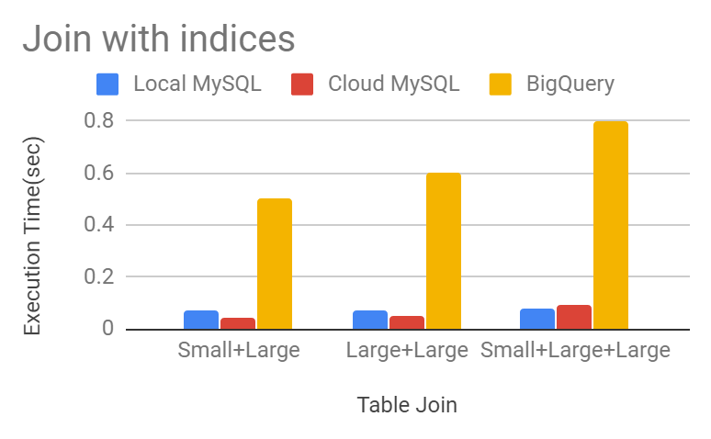
Results for The Experiment
* Join without indices
Table Join | Local MySQL | Cloud MySQL | BigQuery
Small+Large | 0.16 | 0.08 | 0.5
Large+Large | 0.219 | 0.20 | 0.8
Small+Large+Large | 0.187 | 0.13 | 0.9
* Join with indices
Table Join | Local MySQL | Cloud MySQL | BigQuery
Small+Large | 0.073 | 0.04 | 0.5
Large+Large | 0.074 | 0.05 | 0.6
Small+Large+Large | 0.078 | 0.09 | 0.8

Slide 8
Conclusions
In our First experiment, query using indices performed better by using Cloud MySQL than BigQuery as expected.
Smaller selectivity performed better only with using clustered index as per our experiment and we also expected that the performance will be in Decreasing order with the increasing order of selectivity with the use of indices.
In our Second experiment, BigQuery took more time than the other two systems as expected.
Cloud MySQL performed better than Local MySQL as expected because of using nested loop join by the latter.
Both LOCAL MySQL and Cloud MySQL performed more or less equally using Indices on joins

Slide 9
Lessons Learned
BigQuery has a very good cache management system. It takes ‘0’ Second to run the same query again.
Cloud MySQL takes much less time if the same query is executed again and again than it’s first execution.
We noticed that MySQL workbench incur some overheads on the execution time maybe due to its display time and interface requirements which result in more time than MySQL Command line. We chose to use MySQL Workbench because it is user friendly.
On cloud systems joins are selected randomly that is best suited for the query.
Insert a new record on Local MySQL is faster than the other two systems
MySQL does have a non-clustered index command.
If a relation has a primary key it always takes it as a clustered index in MySQL if there are no other indices created.

Slide 10
Thank you!

